Slide 1
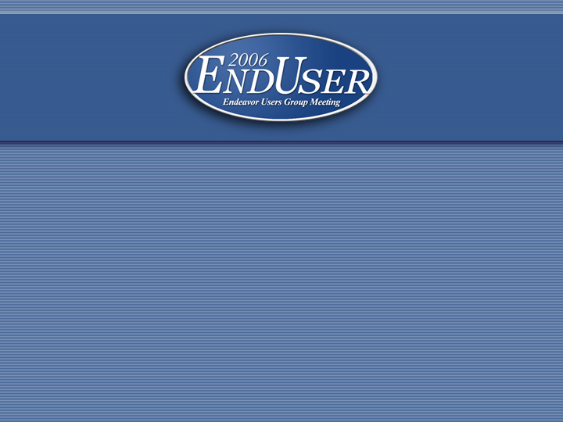
Bib Linking print and electronic records
Joyce Bell
Catalog Division Coordinator
Princeton University
Notes:
Welcome to this presentation on Voyager’s Bib Linking feature.
My talk is centered around why we started using bib linking at Princeton, and how we have chosen to use it. During the course of covering those topics, I will talk about how it functions, show you what the results are in WebVoyage, and I will include information on the configuration needed to set it up. At the end of the talk we will do some live searching in several OPACs who have enabled bib linking. You should be able to return to your home institution with all the basic information needed to implement it yourself.
Princeton implemented bib linking about 3 years ago. I saw two presentations at EndUser 2003 on bib linking from what I believe were the only institutions using bib linking at that time. The Helsinki University Library was using bib linking to connect component parts to their host—they were linking records for tracks on a sound recording to the sound recording as a whole. The other presentation I saw was from the University of South Australia, and it really got me thinking. They were using it in connection with eCollections. I returned to Princeton intent on pursuing this as a solution to …

Slide 2

Cataloging dilemma
Background
  Princeton attempts to use the single record approach for print/electronic versions
  Availability of and reliance on vendor and other externally-supplied records for e-resources causes a mix of the single-record and multiple-record approaches in our catalog
Notes:
… a cataloging dilemma. At the time I was supervising the electronic resources unit. Having started library life as an Arabic cataloger, I was obviously well-prepared for this task. As it happens, that was a good place for me to be at the time because issues related to e-resources were at the forefront of my mind when I got my first glimpse of bib linking.
After some initial back-and-forth, Princeton had finally decided on the single-record approach for electronic journals. This worked well for some time, but inevitably the volume of e-journals as well as the addition of large sets of e-books and other e-resources became too much to catalog locally. We began acquiring files of records for electronic resources which we loaded into our catalog as separate bibliographic records for maintenance reasons irregardless of whether we had print versions. A very familiar story …

Slide 3
Cataloging dilemma
Result: Electronic resources begin causing conflicts between the needs of users and good cataloging practices
  Problem: how does a user find both “Choice (Chicago, Ill.)” and “ChoiceReviews.online”?
  Suggested solution: add URL to both catalog records
  Suggested solution rejected for maintenance and staffing reasons
Notes:
… with an unsurprising result. Public Services was concerned about multiple records being problematical for users, especially in these 3 ways:
Of primary concern was library users finding an e-journal’s holdings and not realizing that we had more extensive back issues in print, or finding print holdings and not realizing that recent issues were available more quickly, and in some cases solely in electronic format.
Secondly, in cases where the title of print and electronic versions were very different—one prime example of this is the serial Choice whose print version has the uniform title: Choice (Chicago, Ill.), while the electronic version is titled ChoiceReviews.online
And finally, cases of very short titles where the presence of |h[Electronic resource] causes the electronic version to be widely separated from the print version in title search results. One of our examples of this is with the e-book C++, the complete reference. The |h before the subtitle causes it to file in the title list 30 titles away from the print version.
In an effort to accommodate Public Services issues, catalogers added special notes to alert users to alternate versions in specific cases like Choice, and Proquest Digital Dissertations, but this was not considered sufficient. A solution was suggested: add the URL to all related catalog records! Do I need to mention that this solution did NOT come from Catalog Division?
None of the in-between solutions we were considering or employing really satisfied both our need to serve users better or to keep to good cataloging practice in keeping maintenance and staffing time to the minimum. Bib linking has proved itself to be a mutually-satisfactory option for all parties.

Slide 4
Bib Linking fits the bill
Bib linking allows self-defined links between data elements in related records.
It can create hyperlinks between separate catalog records for print and electronic versions of the same content.
Notes:
Bib linking works by defining relationships between data elements. For example, a profile can be set up to provide a hyperlink when the content of a 776 subfield x matches the content of an 022 subfield a.
Using bib linking we are able to successfully provide hyperlinks in the catalog between the records for print and electronic versions of the same title.

Slide 5
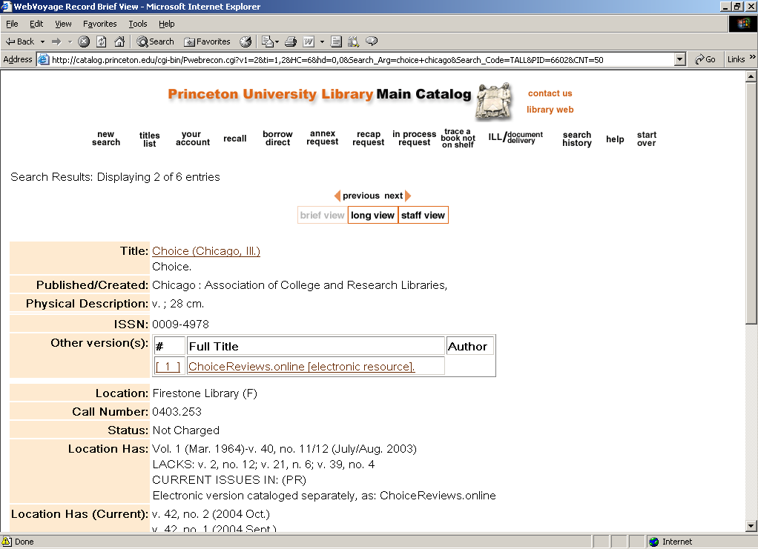
Example from Princeton’s catalog
Notes:
Before we move on to details about how bib linking works and how to configure it, I want to show some screenshots from our catalog to give you a sense of what the result is. This image shows the brief view of Princeton’s record for the print version of Choice. You can see in addition to the standard location display for Firestone Library, we have a hyperlink box to the electronic version of this resource.
We have configured out OPAC so the link also appears on our long display.
There are a number of configuration options for this display. We have chosen the label “Other version(s)”, the same background color as our page, a box around the display, and full title and author as display fields.
You might not think it to look at this display, but unbelievable amounts of discussion, tinkering, explanations, and many choruses of “we can’t change that” went into it.
If you click on the link for ChoiceReview.online, you get …

Slide 6
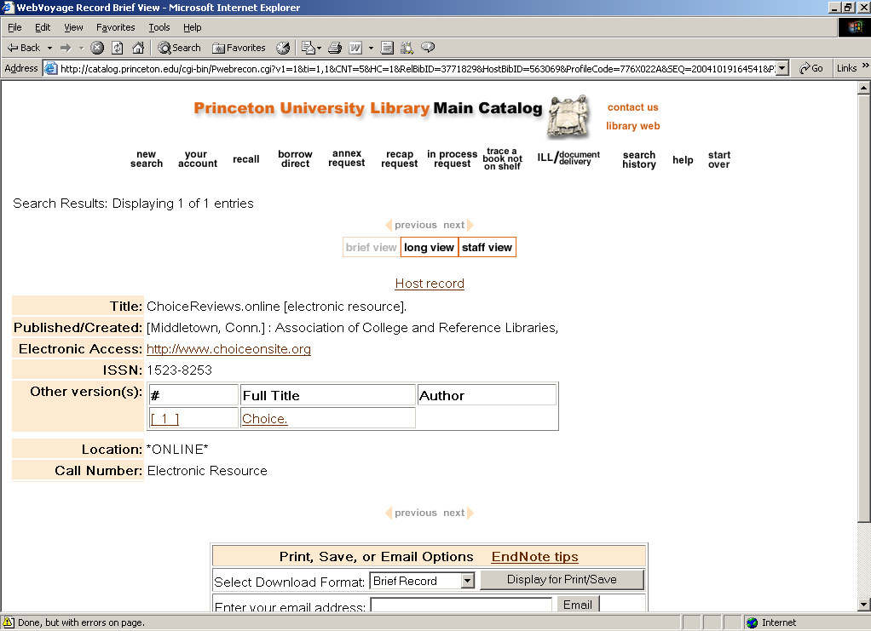
Example from Princeton’s catalog
Notes:
… voila! The catalog record for ChoiceReviews.online.
Here users can access the URL for the online version. This was the accommodation that Public Services made—it requires 2 clicks to get to the e-version with bib linking as opposed to 1 click if the URL was put into all the records.
This record has its own bib linking hyperlink to the print version. Bib links can be reciprocal, but they do not have to be.
Whenever you follow a bib link, you will also get a hyperlink back to the record you started from. This return link is labeled “host record”. There is no documented way to change this wording. I didn’t believe there was any way to change this wording, but in preparing for this presentation I gathered some examples from other catalogs and it appears that one of them has found a way to do this.

Slide 7
How bib linking works
  Bib linking works by defining a relationship between specific data elements in bibliographic records
  When a record is retrieved Voyager will check the defined relationships. If the record meets the first condition in the relationship, Voyager will check for a record which meets the second condition of the relationship.
  There is no absolute link between the two records—the link is created on retrieval
Notes:
So now that you’ve seen the result, you’re probably wondering what is happening behind the scenes to make this happen. This is the brief description, the examples we’ll look at later should make this clearer.
Bib linking is controlled by relationships which users define in the Sys Admin module. You define a relationship between a specific tag/subfield with another specific tag/subfield. For instance, you could be matching on the 780 subfield x and the 022 subfield a. For non-catalogers, this would be defining a relationship between the earlier/later serial records using the ISSN.
The creation of the hyperlink in the OPAC happens on retrieval and display of the record. When WebVoyage prepares to display each bibliographic record of a result set it checks the defined bib linking relationships. If a record contains a tag/subfield specified in the first part of a bib linking relationship, it will look for any records in the database which have identical data in the tag/subfield specified in the second part of the relationship.
The beauty of this system is that the hyperlink can be made without any Voyager-specific data being added to either record. It can be based on standard MARC-defined fields already present in the record. Simply by defining a relationship you can create dozens or hundreds of hyperlinks based on data already present in your records. Conversely, you can also manually create individual links by adding appropriate data to records.
An ever-present issue with electronic material is the transitory nature of some of a library’s holdings. These are handled simply with bib linking—if a record is deleted and there is no longer a record which matches the second part of the relationship, the link is simply not made upon record retrieval. There is no maintenance required to remove obsolete links.

Slide 8
How bib linking works
Characteristics of bib linking
  Flexible
    unidirectional links can be made between records
      article in book to book as a whole
      individual track to sound recording
    bidirectional links can be made
      e-book to print / print to e-book
    multiple reciprocal links can be made
      e-resource containing multiple serials / individual serials to e-resource
  Data-driven
Notes:
I would characterize bib linking as flexible and data-driven. It can be set up on just about any subfield, with the limitation that the “link to” side of the relationship must have a left-anchored index, and the display of the results can be configured to match your OPAC.
The hyperlinks provided depend on the data. With our print and e-versions we have chosen to provide links in both directions.
We are in the throes of implementing a new profile for parent/child relationship which will only provide links from the child to the parent.
And, as you’ll see later, a single record can have links to hundreds of related records.

Slide 9
How do I get there from here?
There are two aspects to making bib linking function:
  Setting up the configuration
    display.cfg file(s)
    opac.ini file
  Defining the relationships
    System Administration module
Notes:
So, how is bib linking set up?
To get bib linking functional in your catalog, there are two aspects you need work on: setting up the OPAC configuration, and defining the relationships. The files which control the behavior and appearance of bib linking are in the display.cfg files and in the opac.ini file. Relationships are defined in the System Administration module.
Deciding which of these aspects to start with is like deciding whether the chicken or the egg came first, so I will arbitrarily start with setting up the configuration.

Slide 10


Configuring bib linking
Configuring displayN.cfg:
  For each display you want bib linking to appear in (brief, long, etc.) you need to add the name of your bib linking profiles under the desired label
Notes:
The display.cfg file additions are quite straightforward. At Princeton we decided to include the hyperlinks in both our brief and our long displays. Our file names for those two displays are “display1.cfg” and “display2.cfg”.
Our initial use of bib linking was confined to print and electronic versions of a resource, so they are all under the label “Other version(s):”. You can see on this slide the category we added to our display1 and display2 config files. Under the chosen label of “other version(s)” a line has been added for each bib linking profile. Each profile name line starts with three spaces, then the code 3500, then the name of the profile. You create the profile name when you define a new relationship in the System Administration module. Along with the profile name you can include “+No Related Record”. Doing so will cause this text to ALWAYS display when bib linking does not occur. We decided early on to omit this statement.
At the time when I copied these lines from our config files, we had 6 bib linking profiles under “other versions”. If you look at the names of the profiles, you should be able to get an idea of what we are linking.
We now have additional bib linking profiles under both “Other version(s):” and a new one under the label “Contained in:”

Slide 11
Configuring bib linking
Configuring opac.ini:
  Two stanzas need to be configured:
    View_Record_Page
      This stanza determines both the normal display and the display for a record with a large number of links
    Max_Related_Records_Page
      This stanza determines the appearance of the web page that appears when the maximum no. of records has been exceeded
Notes:
The two stanzas on this slide, View Record Page and Max Related Records Page determine the appearance and behavior of bib linking lines.
The first stanza controls bib linking within the source record.
Because it is possible to create links for relationships like host/component part, a bib record may be linked to a large number of other records. Bib linking allows you to set a limit on the number of links that will display within the record. If the limit is exceeded, the normal bib linking line will be replaced by a text link leading to a separate page with all the links, and this page’s appearance is controlled by the 2nd stanza.

Slide 12
Configuring bib linking
Configuring opac.ini:
  View_Record_Page stanza
    There are 4 lines to add/fill in which determine:
      limit of links to appear on the record
      message to display when the limit has been exceeded
      background color and border for bib linking line
Notes:
The View_Record_Page stanza has 4 settings.
One line allows you to set a limit on how many links will appear within the record. We have several electronic resources which are composed of a dozen or more print titles. While we want to provide hyperlinks between the print and electronic records for these titles, we don’t want the record for the electronic resource to be interrupted and overwhelmed by a long list of links. In the View_Record_Page stanza, you can set an upper limit for the number of links that will display within the record. When the limit is surpassed, bib linking will provide a single hyperlink to a separate page which will contain the links.
Another line in this stanza allows you to choose what the text of the hyperlink to this separate page will say.
The other two lines in the stanza allow you to choose the background color for the bib linking line in the record, and presence and thickness of a border.

Slide 13

Configuring bib linking
Configuring opac.ini:
  View_Record_Page stanza
    Princeton’s choices:
Notes:
Here you can see Princeton’s current choices.
We have chosen 5 as our limit for the number of links to appear within the record. When there are 6 or more matches, the record will have a single hyperlink with the text shown in the second line -- “Click for related titles” -- instead. When the limit is surpassed, the hyperlink follows normal appearance for your site, choices for background color and border are not employed.
For the background color of our linking area, we have chosen the ever-popular ffffff (white). The color choice is given in hexadecimal code. The last line shows our choice for the border—we decided to include a border, and we are using “1” which makes the border width the same as other table displays in WebVoyage.
Our overall record background is also white. Initially we tried a light shade for bib linking background to draw attention to the hyperlink. We abandoned the color quite quickly because it drew too much attention to the hyperlink.
You saw earlier the result of these choices in our OPAC when the limit was not exceeded.

Slide 14
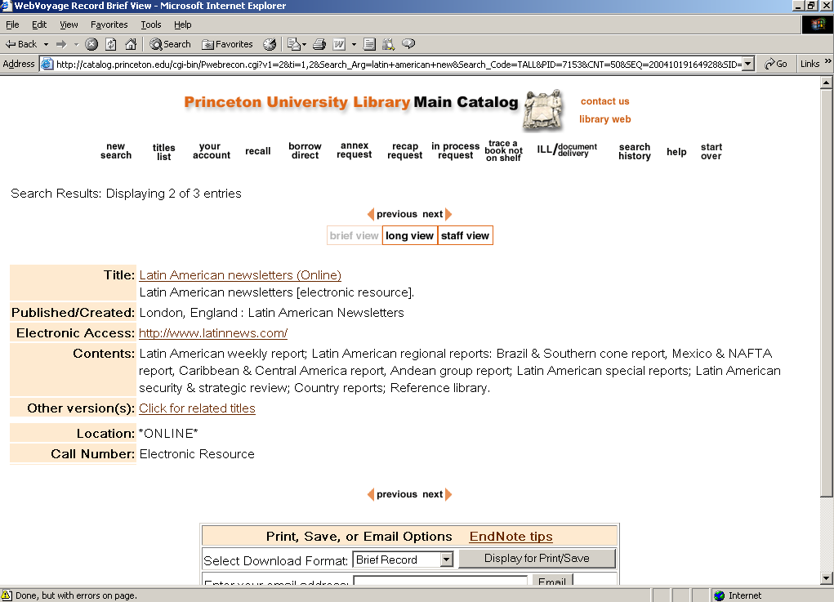
Slide title goes here
Notes:
Here is an example from Princeton’s catalog of a record which exceeds our limit of 5 links. We have an electronic collection of Latin American newsletters. Since there are 7 individual newsletter titles in this collection which we also have in print, Click for related titles appears in our record because we have exceeded our limit. The bib linking box does not appear.
The appearance of the link page which appears when we follow this hyperlink is controlled by …

Slide 15
Configuring bib linking
Configuring opac.ini:
  Max_Related_Records_Page stanza
    There are 17 lines which can be used to determine colors, text, and hyperlinked elements on the page when the limit has been exceeded
Notes:
… the Max_Related_Records_Page stanza, also found in the opac.ini file. This is a more extensive stanza with 17 lines to determine appearance and behavior.

Slide 16
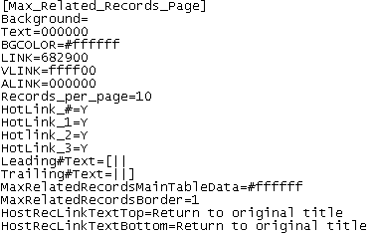
Configuring bib linking
Configuring opac.ini:
  Max_Related_Records_Page stanza
    Princeton’s choices:
Notes:
With the first 6 lines in the stanza you can set background color or image, text color, and the color of links before, during, and after they are being clicked. These lines are the same as those in the Html_Body stanza (also in the opac.ini). If you want the Max_Related_Records page to have the same general appearance as your site, you can use the same settings.
The next choice is the limit of records per page. If you have 100 related resources linked to a particular record, you may want to limit the number to to users don’t have to scroll. Users will click the “next” button to see the next set. We have set our limit for the related records page at 10. While we have some sets which exceed our basic limit of 5, we don’t yet have bib linking profiles which result in large numbers of links. We will soon be loading a large number of records with parent/child relationships which we intend to bib link. These will frequently exceed not only the initial limit of 5, but also this secondary limit of 10, and we may reconsider this limit.
The “Hotlink” lines allow you to choose which columns will be hyperlinks. The “Y” shown here reflects our choice to make all columns in the bib linking section hyperlinked.
We chose to surround the line number with bracket-space on either side. This is done using the Leader and Trailing text lines.
The following 2 lines, like the similar lines in the View_Record_Page stanza, control the background color of the link area, and the border. We chose the same settings for a uniform appearance. White background with a border.
The final two lines allow you to choose the text for the hyperlink that appears at the top and bottom of the page which will return to the user to the record they started from. Our choice is “Return to original title”.

Slide 17
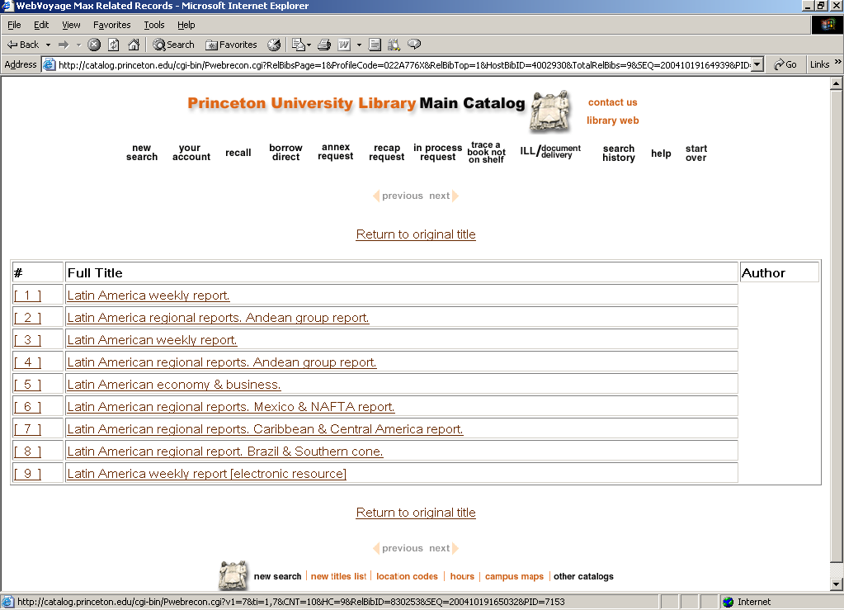
Slide title goes here
Body text goes here:
  Bullet
    Bullet
      Bullet
Notes:
Here you can see the result of our choices. This is the related records page for our Latin American newsletters title. When users follow the “Click for related titles” link, this is the result.
Here is the exciting ffffff background color and small border, and the “Return to original title” link at the top and bottom of the page. Here you can see the result of the Leading and Trailing text for our line number—the number is surrounded by space and bracket. And both number and full title are hyperlinked, as would Author be if these titles had authors. With different choices in the Max_Related_Records_Page stanza, the number alone could be hyperlinked.
We have not exceeded our limit of 10 for this page, so the Next button is not active.
Later in the presentation I will show you bib linking in some other catalogs, and we can see the result of different setting choices.

Slide 18
Defining the relationship
  Recap:
  Bib linking works by defining a relationship between specific data elements in bibliographic records
  When a record is retrieved Voyager will check the defined relationships. If the record meets the first condition in the relationship, Voyager will check for a record which meets the second condition of the relationship.
  There is no absolute link between the two records—the link is created on retrieval
Notes:
Now we’ll switch to the other aspect of setting up bib linking—defining the relationships. Remember, bib linking relies on matching data in specified subfields when the record is retrieved. There is no “hard-wired” connection between the records.

Slide 19
Defining the relationship
Getting started:
  Goal: link between the bib record for Choice and ChoiceReviews.online
  Step 1: Look at the records to determine what elements are already present in our cataloging which would be good choices for linking
Notes:
I’m going to use the serial “Choice” as an example of how one of our bib linking profiles was set up. Public Services staff had complained to me about the difficulty of finding the electronic version of this particular serial because the title for the e-version was so different.
I started by looking at the records for these two titles to see what was already in the cataloging which would work for bib linking. Because links are made on the basis of matching data in a particular tag/subfield and potentially affect every record in the database, I was reluctant to work with non-unique data like titles.

Slide 20
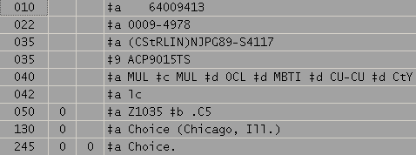
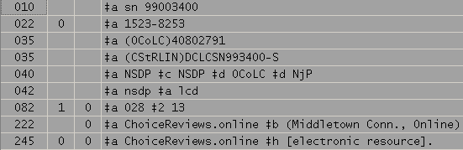
Defining the relationship
Goal: Create reciprocal links between the records for Choice and ChoiceReviews.online
Notes:
Looking at these records, the decision seemed pretty obvious. Both records were nicely cataloged with their own ISSNs, and with 776 fields for the alternate format version, including the ISSN for that alternate version.

Slide 21
Defining the relationship
Looking at our cataloging, I decided to create a profile for 776x and 022a
Notes:
By creating a profile to link from 022a to 776x, we got the desired connection between these two records. Furthermore, with that one profile, the linking would be reciprocal based on the existing data.

Slide 22
Defining the relationship
  In deciding on this relationship, I had to consider not only these two records, but every record in our database which has a 776x or 022a
  To prevent false links, we have restricted our profiles so far to control numbers: ISSN, ISBN, and record number
  Limitations
    While you can use any subfield in the source record, you must link *to* a subfield which has a left-anchored index
Notes:
Although I have started most of our profiles by considering specific examples which we want to link, before establishing the profile, it was necessary for me to expand my view to our data in general. Linking from 022a to 776x will link *every* records in our database where the content of these subfields matches.
In an effort to prevent unexpected and unwelcome links, so far all of our profiles are based on control numbers and record id numbers.
(And, by the way, I have not succeeded in preventing some unexpected and unwelcome links.)
The main limitation to bib linking is that there must be a left-anchored index for the subfield that you are linking to.

Slide 23
Defining the relationship
System Administration module:
  Create a new profile
    Search: Bibliographic Record Linking: New
  Use the left-anchored index 776x with an override for 022a
Notes:
To create the profile that we chose to link Choice and ChoiceReviews.online, we go to the System Administration module.
We want to start in the source record with 022a and link *to* 776x, so we must have a left-anchored index for 776x and Princeton does. This is one of several indexes that we asked Endevor to build for us specifically for bib linking.

Slide 24
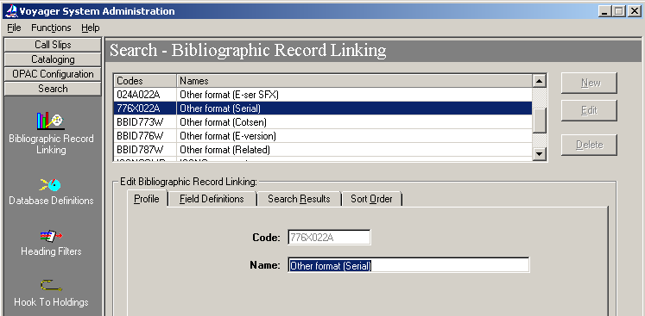
Defining the relationship
System Administration:
Notes:
Here we see what the profile looks like in Sys Admin. On the Profile tab, the
“code” name assigned here is what must be added in the opac.ini file to make the profile active in your OPAC.
The “name” assigned here is what will display in the cataloging module which we will be looking at later.

Slide 25
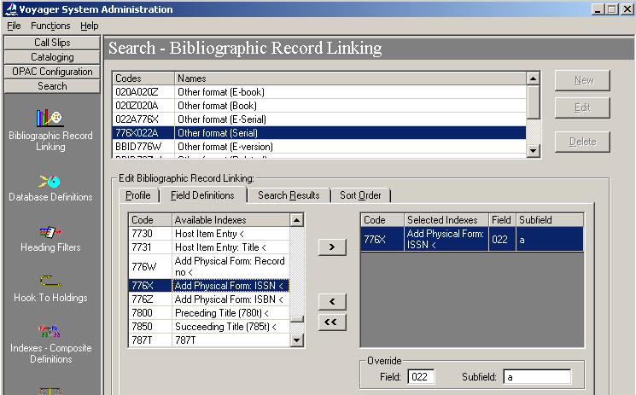
Defining the relationship
System Administration:
Notes:
The Field Definitions tab is where the 2 sides of the relationship are set. The list in the left-hand side contains most of your defined left-anchored indexes. For details about what indexes are *not* included here, see the Sys Admin documentation on indexes in section 8.
The index you choose from the left-hand side list represents the field you will link *to*.
The override box on the bottom represents the “first” part of the relationship—the data on the source record that you will link *from*.
If no override is chosen, the field will link on itself—without the override this profile would link all records in the database which have identical data in the 776x field.

Slide 26
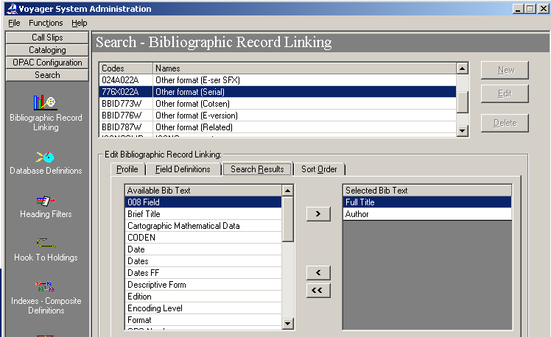
Defining the relationship
System Administration:
Notes:
On the Search Results tab you choose the columns that will display.
We have chosen Full title and Author for all of our profiles, although the name field is blank for many of our serial titles.

Slide 27
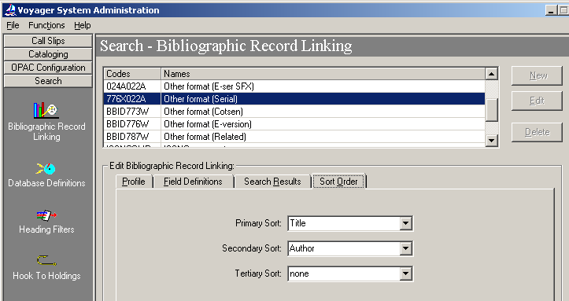
Defining the relationship
System Administration:
Notes:
Finally, you can choose the sort order of the links.

Slide 28
Defining the relationship
When Voyager retrieves this record:
It checks for the presence of an 022a. Since it finds one, it searches for a match on the content of that field (0009-4978) with identical content in a 776x
Notes:
So, once this profile is configured, when Voyager retrieves this record, it checks for the presence in the record of the “first” part of the relationship, the 022a override. The record contains an 022a, so Voyager does a search on the contents of that subfield “0009-4978” and tries to match that number with the content of a 776x subfield in the database …

Slide 29
Defining the relationship
Voyager finds a match with content of a 776x, so it creates a hyperlink in the opac:
Notes:
… and it finds a match with this one record, so a single hyperlink is created on the record.

Slide 30
Defining the relationship
Since both records have 022a and 776x, the process also works in reverse. With one bib linking profile we get reciprocal links.
Notes:
The same process takes place when a user retrieves the ChoiceReviews.online record. Before displaying the record, Voyager will check to see if the record matches the first condition of any bib linking profiles—it does, it has an 022a. Voyager looks for the data in that subfield “1523-8253” in a 776x subfield. It finds a match with the record for Choice, so a hyperlink is displayed.
You’ve seen the result in earlier screenshots from Princeton’s catalog.

Slide 31
Defining the relationship
  Dilemma: Reserves wanted to alert users to electronic versions of material on reserve
  Pre-bib linking solution: Identify when e-books were available, create item records for them to put them on reserve, delete item records when taken off reserve
  Post-bib linking solution: do nothing
Notes:
Another catalog dilemma we solved with bib linking related to reserves. While putting print material on reserves, our staff were finding e-versions on separate records. In order to alert students to the availability of an e-version, staff were identifying them, creating items records for the electronic versions in order to put them on reserve, and then deleting the item records at the end of the semester.
We had thousands of vendor records for e-books which had already been loaded into our catalog as separate records, changing that wasn’t an option. We were able to create a bib linking profile for those records. The hyperlink within the print record which was on reserve alerted students to the availability of an e-version without the reserves staff having to do anything at all.

Slide 32
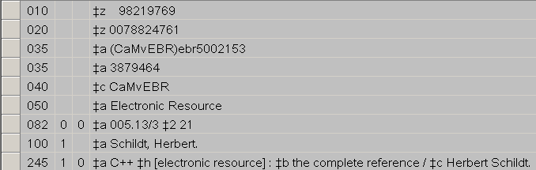
Defining the relationship
  Most of the material involved came from several e-book vendors for which we had loaded MARC records
  Investigating the data revealed that the e-book records included the print ISBN in an 020z
Notes:
Our e-books came in large packages with MARC records which had already been loaded in our catalog. When I investigated the possibility of bib linking them, I found the e-book records had the print ISBN in an 020z. This made a very obvious choice for a bib linking profile based on the ISBN, although this has been our most troublesome profile.
I’m sure some of you can already anticipate problems linking from the 020a to 020z. The 020z is defined by MARC for use with invalid or cancelled ISBNs. By creating this profile, in addition to the desired links between print and e-books, we also got some false links between completely unrelated titles. If we were loading the e-book records now, I would re-map the print ISBN to a more appropriate MARC field. I’m happy to say that some of our more recent vendor records have the ISBN in the 776z.

Slide 33
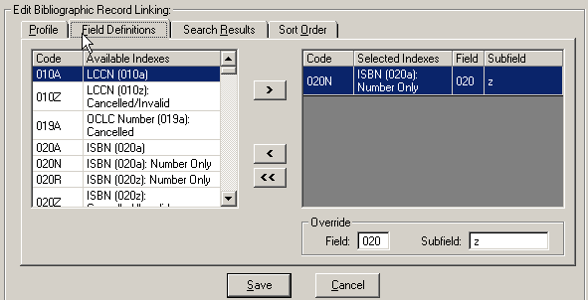
Defining the relationship
Profile established for linking e-book records to their print counterparts:
Notes:
The other main problem area with this profile has to do with the ISBN indexes available. Prior to the Unicode version of Voyager, the ISBN indexes included the entire subfield content—number and qualifier both. This prevented some related records from linking when the qualifiers weren’t identical on both records. And, indeed, I get e-mails from reserves occasionally about records which should be linking and aren’t for this very reason.
Along with Unicode, we got new 020N and 020R indexes which index only the number in the subfield a and z respectively. (I believe technically it indexes up to the first space.) The slide shows the change I made when this index become available. I didn’t think this profile would work, because I expected the override subfield to include all data in that subfield, including the qualifiers. The profile does work, and the qualifiers no longer have to be identical, or even present, on both records.

Slide 34
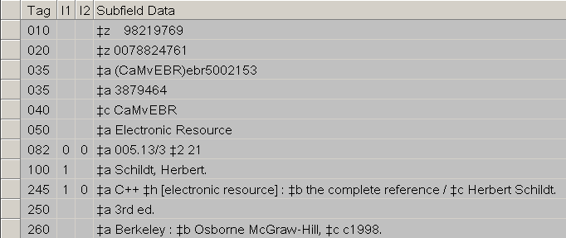
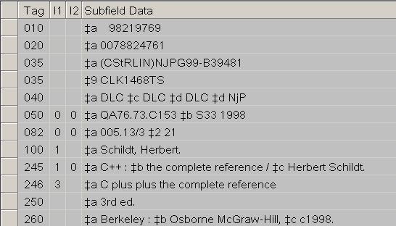
Defining the relationship
This profile
creates a
unidirectional
link because
of the data.
To create reciprocal links
we established a second
profile from 020a to 020z
Notes:
In order to get reciprocal links in this case, we needed a second profile. The print records don’t contain an 020z, so no linking will take place.
To make a link the other direction, a second profile from 020a with an override on 020z was created. For this profile as well, the new ISBN indexes which came with Unicode were useful. I changed the left-anchored side of this profile to the new 020R index which includes only the number portion of the 020 subfield z.

Slide 35
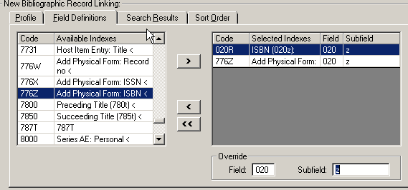
Defining the relationship
Multiple elements may be included in the profiles, either as elements to link to (see below), or multiple subfields in the override to treat as a single data element.
Notes:
It is possible to create a profile based on multiple elements.
I have not tried this myself, but according to the documentation, if you choose more than one “link to” index, as shown on the slide, Voyager will begin with the first index selected and work its way down through the list of selected indexes looking for matching bib records. In other words, you can start with an override on 022a, and check for that ISSN number in several different fields.
You can also set up an override with more than one subfield, in which case it treats the data from those subfields as a single string. More information on how Voyager processes bib linking profiles can be found in the System Administration documentation in table 8-1.

Slide 36
Defining the relationship
When we began defining profiles our goal was to take advantage of existing data
  Profiles currently in use:
    020a to 020z
    020z to 020a
    022a to 776x
    bib id to 787w
    bib id to 776w
    022a to 024a
    024a to 022a
    776x to 022a
Notes:
Our initial uses for bib linking were all taking advantage of existing data to solve specific problems, and this worked well for us. We created an unknown but significant number of links with no data manipulation.
As soon as the first few profiles were set up in our production database and library staff in different parts of the library encountered links, I began to get requests for other links. Sometimes the links requested fell into one of the categories covered by a profile which hadn’t linked because of missing or incorrect data, and these were easily fixed. Sometimes, however, the request couldn’t be accommodated by an existing profile, so we set up a profile to link between bib id and 787w. This permits us to create on-demand linkages using an appropriate MARC tag when the relationship isn’t straight-forward, and even when no ISBN or ISSN is available. We do bend MARC a little by omitting the parenthetical qualifier for our institution which should appear before the number.
To make these links reciprocal, the 787w must be added to both bibliographic records.

Slide 37
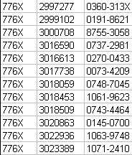
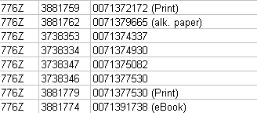
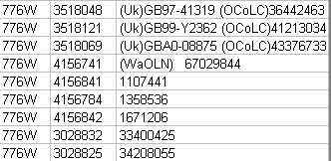
Defining the relationship
Knowing your data:
  Take advantage of the left-anchored indexes that will create one side of your profile to alert you to potential problems and data discrepancies
Notes:
My first bib linking profiles didn’t go quite as smoothly as I have suggested in this presentation. My example records all worked exactly as I planned, but as soon as the profiles went live, false links and double links started appearing. I offer this piece of advice to other embarking on their first profiles: know your data! I don’t have direct access to the table underlying the left-anchored indexes, but I get our Systems Office to provide me with extracts, and these are helpful to alert me to potential problems.
I show here snippets of our 776x, w, and z tables. While the x table is very standard, you can see even in these small sections, variations in the other data. I have found use of these tables helpful in planning.

Slide 38
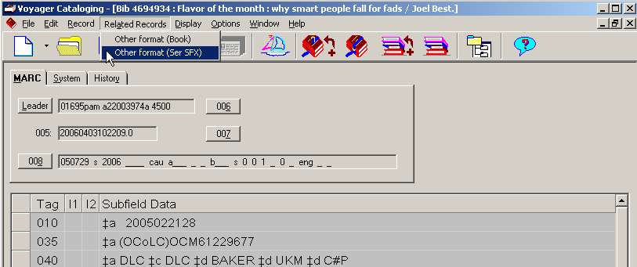
Cataloging module
  Bib linking links don’t appear in the staff module, but the related records can be retrieved through the “related records” menu
Notes:
So far I have only shown and discussed results in the OPAC. Within the cataloging module, bib linking is visible in a different way. If the record displayed matches the first condition of one or more profiles, an extra menu option “Related Records” will appear. all of the potential profiles will be shown. In this particular case, the records matches the first condition of two different profiles. In this menu the profile name instead of the profile code appears.
If there is a match based on the profile, clicking on its name will open the related records. If there are no matches based on the profile, instead you will get the message: “No related records found for the selected profile.”

Slide 39
Bib linking problems / quirks
  Problems caused by insufficient thought and bad data:
    020a to 020z
    020z to 020a
  These profiles created false links between unrelated records based on invalid ISBNs. We have also found multiple false links from incomplete ISBNs (like “pbk.”)
Notes:
Before we move on to live searching, I want to mention some problems and quirks with bib linking.
I have already described the problems I’ve encountered with the profiles for book and e-book links.

Slide 40
Bib linking problems / quirks
  Problems/quirks of the system:
    In some versions of Voyager bib linking will create an “empty” link to records which are suppressed (this appears to be fixed in V5)
Notes:
A quirk of the system with some versions of Voyager is that an empty bib linking line will appear if the data matches a field on a suppressed record.

Slide 41
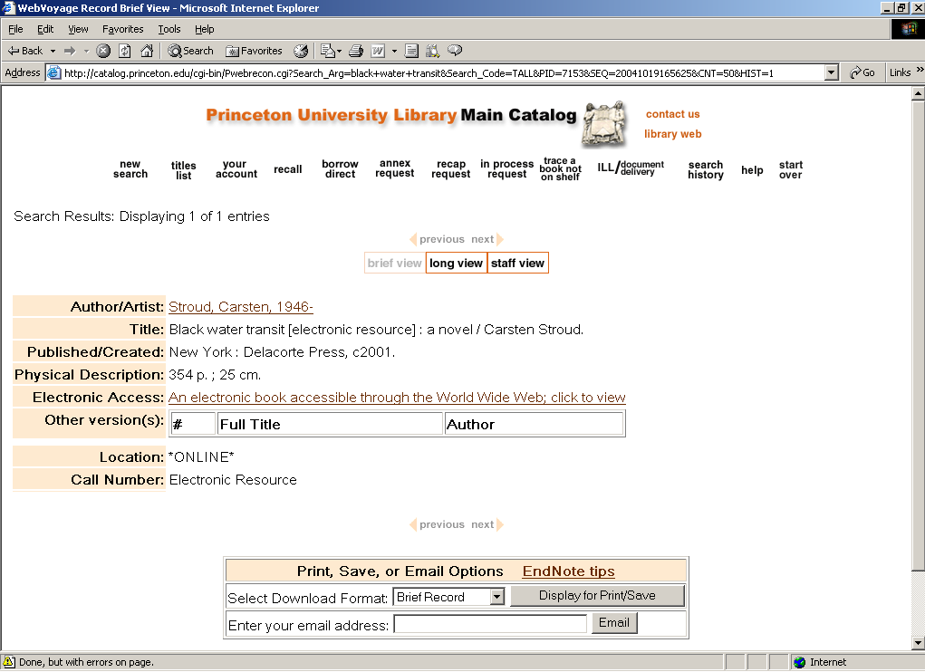
Bib linking problems / quirks
Notes:
This slide shows what this looked like in our OPAC before the Unicode upgrade. I am not sure with which version of Voyager this behavior changed, but I was not able to replicate it in Voyager 5 which is our current version.

Slide 42
Bib linking problems / quirks
  Problems/quirks of the system:
    Bib linking does not de-dupe links. If two records meet the definition of more than one profile, two identical links will be created
Notes:
The other quirk of the system is that Voyager does not de-dupe links. If two records meet the conditions of more than one profile, two links will be created between those two records.

Slide 43
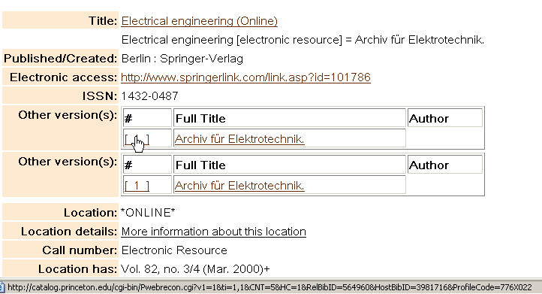
Bib linking problems / quirks
Both links are to the same resource. Note the line at the bottom of the screen.
Notes:
Here is an example of two links to the same record.
When more than one record matches based on a single profile, the titles will be listed in a single list. When records match based on different profiles, they will be in separate lists as seen here.
As it happens, these links are to the same record because these two records meet the definition of more than one profile.
When the cursor hovers over the link, the bottom of the screen will display a line showing which profile generated the line—although the profile name is at the end and often gets partially cut off. Nonetheless, this can be very helpful for troubleshooting.
You can see that the top link is generated from the 776x022a profile …

Slide 44
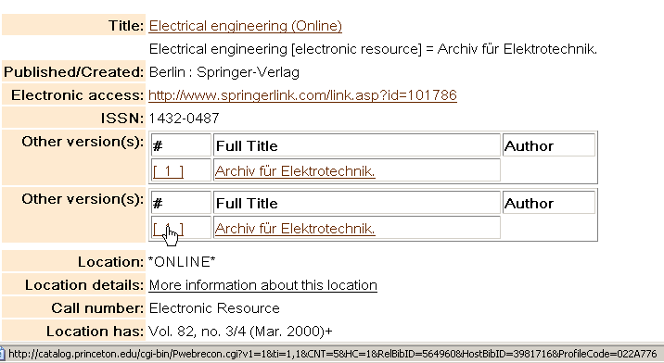
Bib linking problems / quirks
Both links are to the same resource. Note the line at the bottom of the screen.
Notes:
… and the bottom link from the 022a776x profile.
While the lack of de-duping is a quirk of the system, nearly all of the double links I’ve encountered are basically my own fault. Our Public Services staff really, really wanted reciprocal links for e-versions of serials. Many of our earlier print journals have not been updated to include the e-ISSN, so I created two profiles. For those print journals which *have* been updated, we get double links.
I have the intention of using the 776x left-anchored index to do some cleanup in this area. I have had this intention for a long time.

Slide 45
Examples of bib linking
Princeton Univ. Library (http://catalog.princeton.edu)
  Digital lunar orbiter photographic atlas …
  ProQuest digital dissertations
  Dictionary of the Scots language
Helsinki Univ. Library (http://arsca.linneanet.fi/)
  Concerto for orchestra music …
  Five symphonies (Mendelssohn)
  Piano concerto no. 2
  Kirjastot musiikkitarjonnan …
Univ. of South Australia (http://catalogue.library.unisa.edu.au/)
  ScienceDirect electronic resource
  Annals of Mathematics
  Symphony no. 1 in c
  Mass in C minor, K427

Slide 46
Derivation fields
  Voyager has a feature for deriving data from an existing record into a new record.
  By using special coding in a template, you can pull information from specific subfield(s) of an existing record into the field specified in the new record.
  This feature is documented in the cataloging manual.
Notes:
I don’t want to end my presentation without mentioning a few final details. Voyager has a feature to pull specified information from an existing bib record into a new through use of derivation fields in a template.
In a template you can code a field to pull information about of specific subfields of a related record. This is one method that can be used to create related records for bib linking.
You can read more about this in the cataloging manual.

Slide 47
Documentation
  Pre-Unicode: there is a manual specifically for bib linking
  Unicode: the information is split and incorporated into the cataloging, system administration, and WebVoyage manuals
    version 5
      System Administration: 8-8 +
      WebVoyage: section C
      Cataloging: section 5
Notes:
Other places in the documentation where bib linking information can be found depends on which version of Voyager you are using.
Before the Voyager with Unicode version, there was a single manual covering all aspects of bib linking.
With the Unicode version and beyond, the documentation is split between the cataloging, System Administration, and WebVoyage manuals. This slide shows where in those manuals the information can be found for—at least in version 5.

Slide 48
Bib Linking
Questions?
Notes:
I thank you for your attention. At this point I would be happy to address any questions you might have.

Slide 50
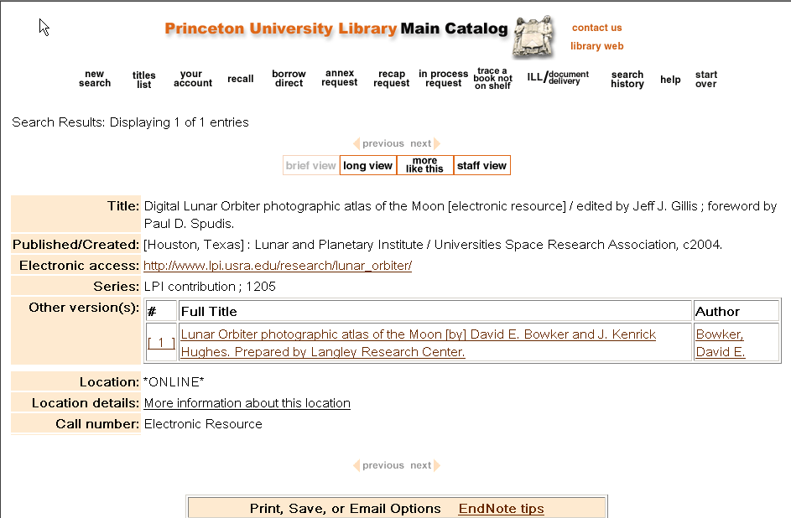
Princeton University

Slide 51
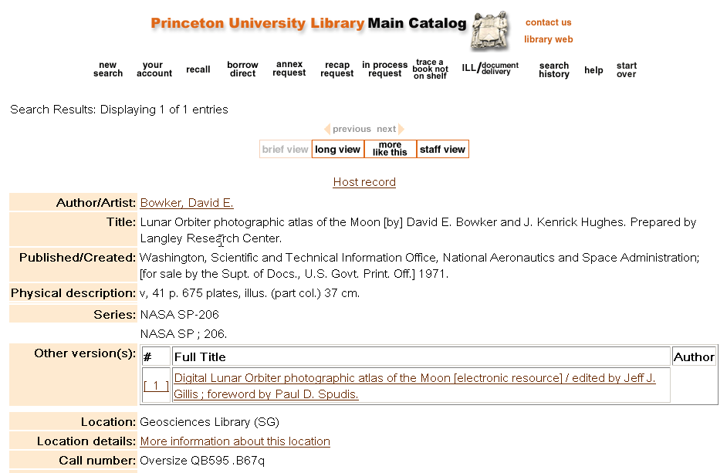
Princeton University

Slide 52
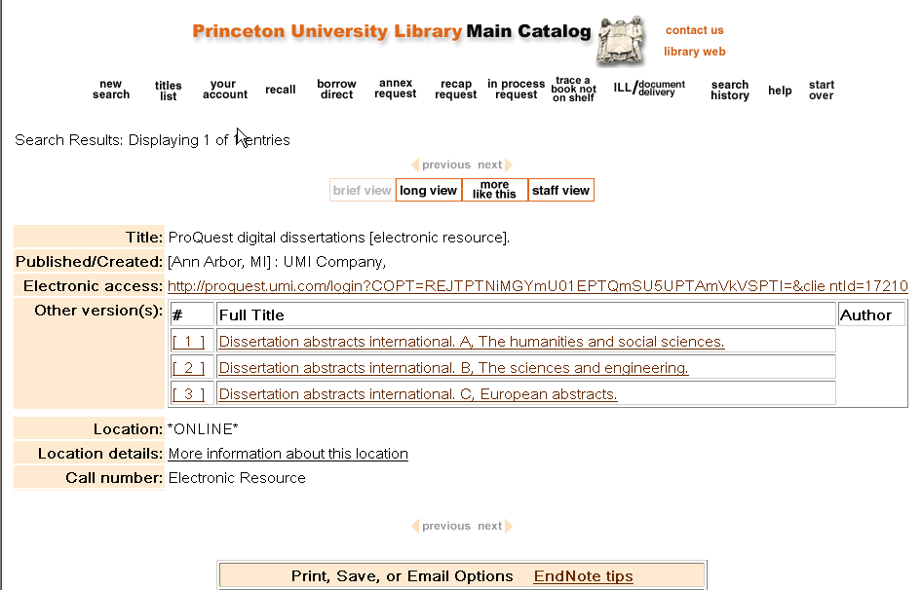
Princeton University

Slide 53
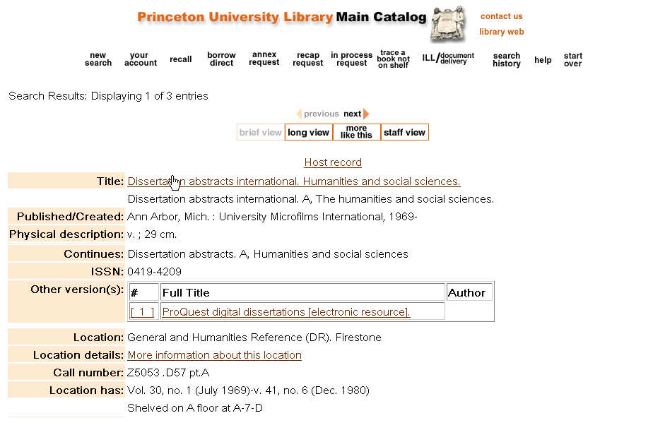
Princeton University

Slide 54
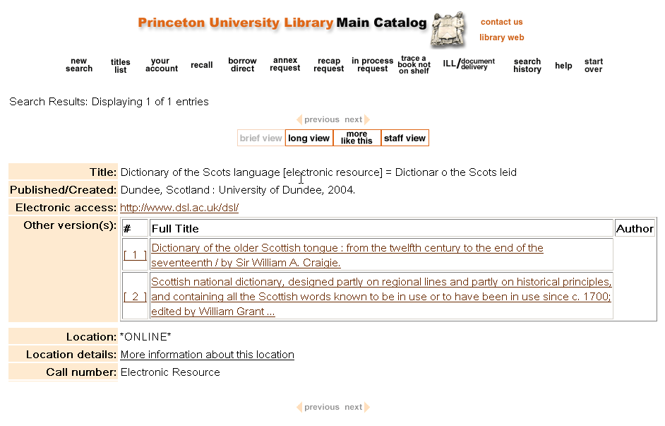
Princeton University

Slide 55
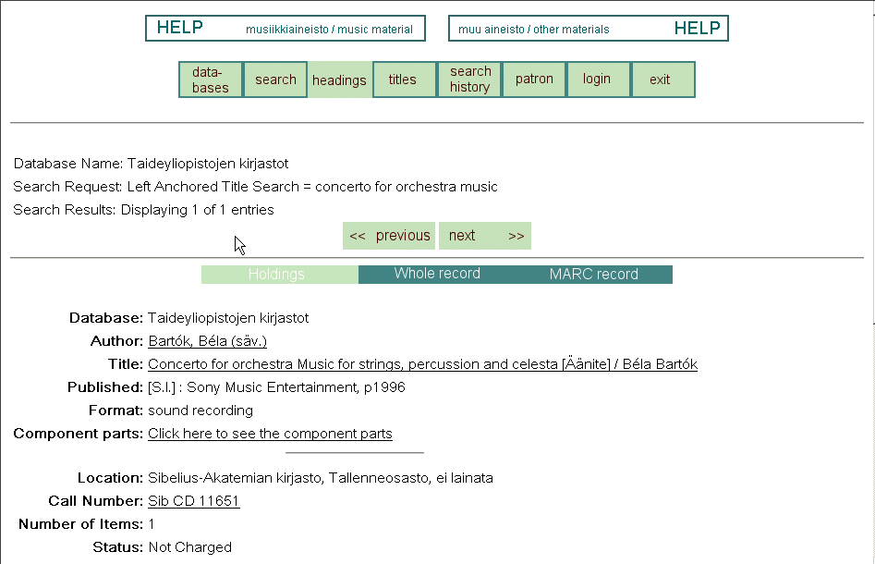
Helsinki University Library

Slide 56
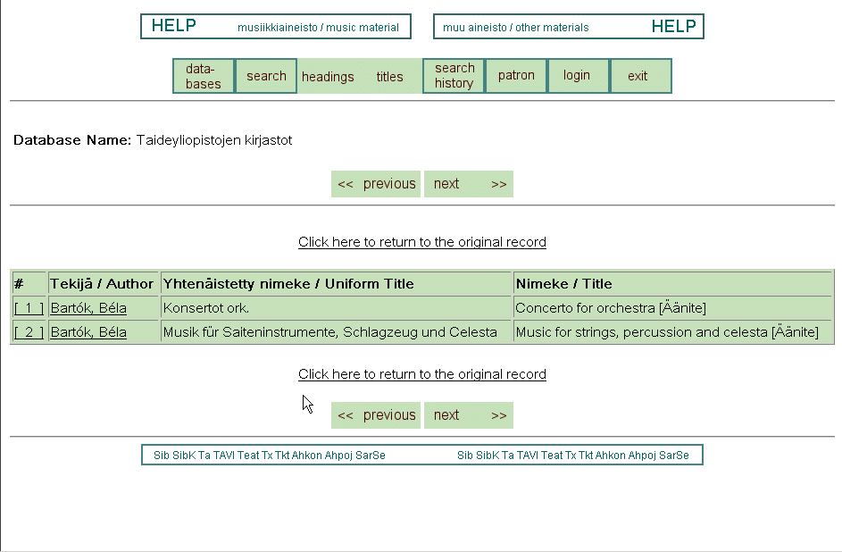
Helsinki University Library

Slide 57
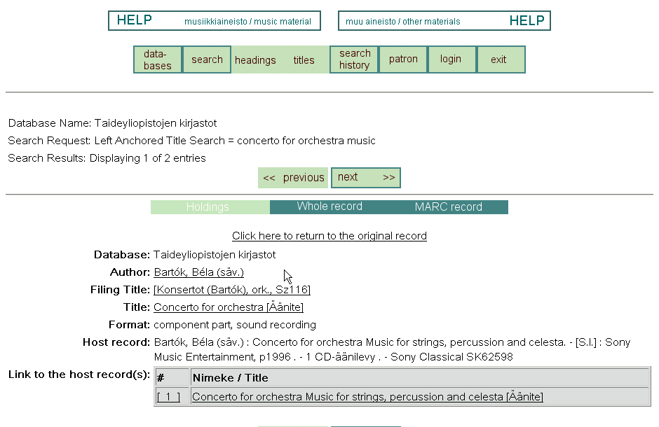
Helsinki University Library

Slide 58
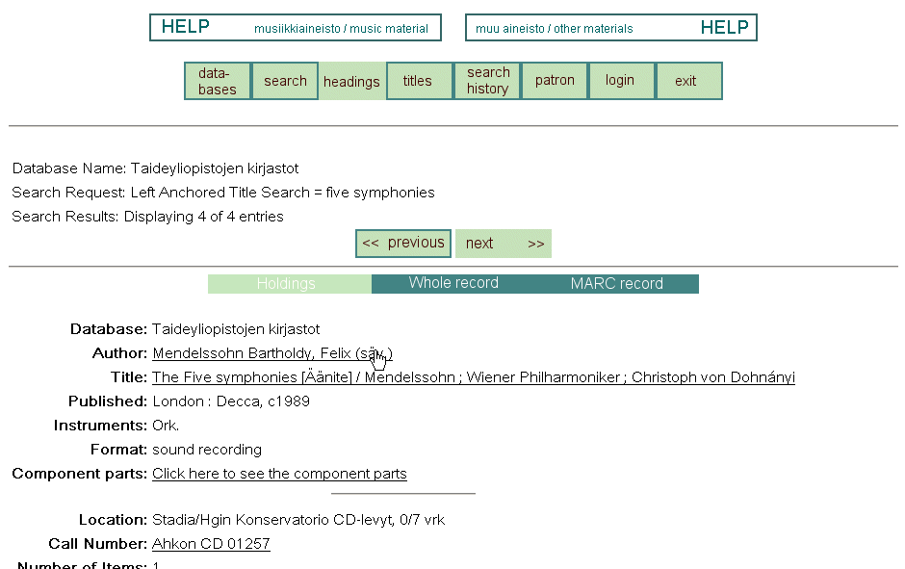
Helsinki University Library

Slide 59
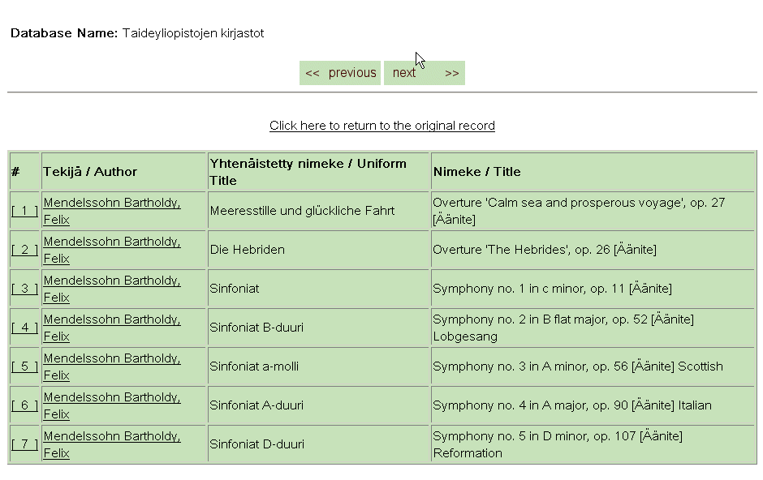
Helsinki University Library

Slide 60
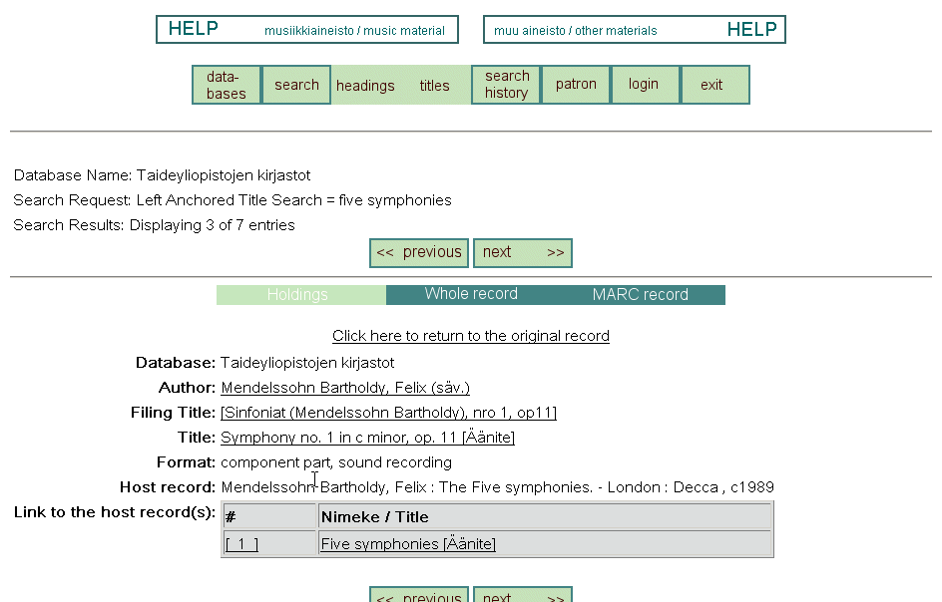
Helsinki University Library

Slide 61
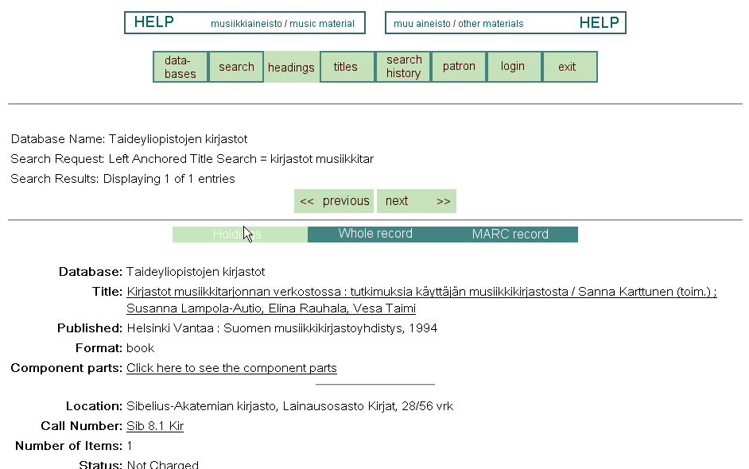
Helsinki University Library

Slide 62
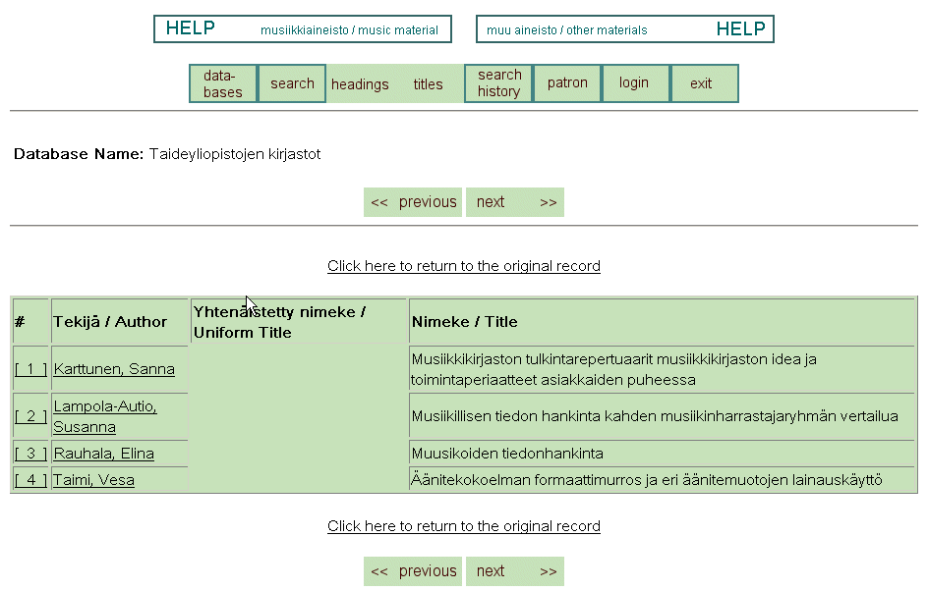
Helsinki University Library

Slide 63
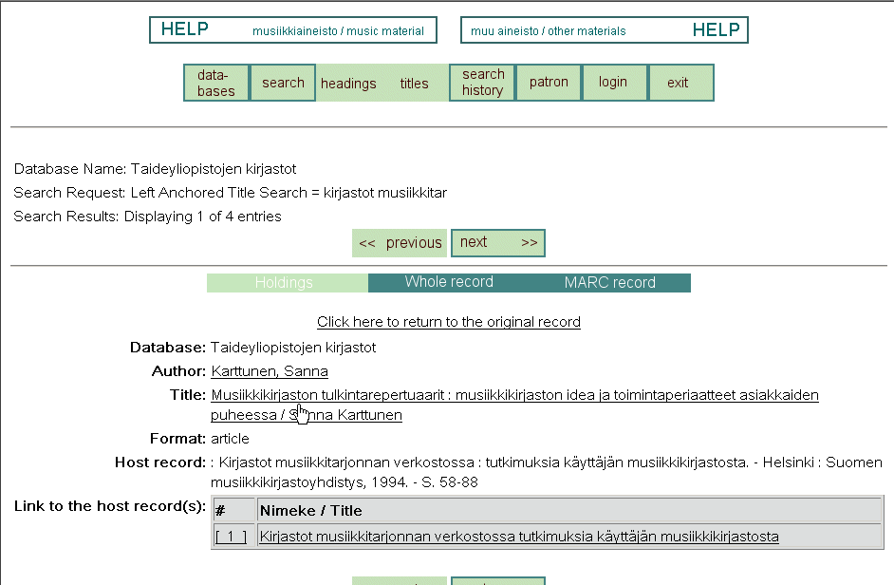
Helsinki University Library

Slide 64
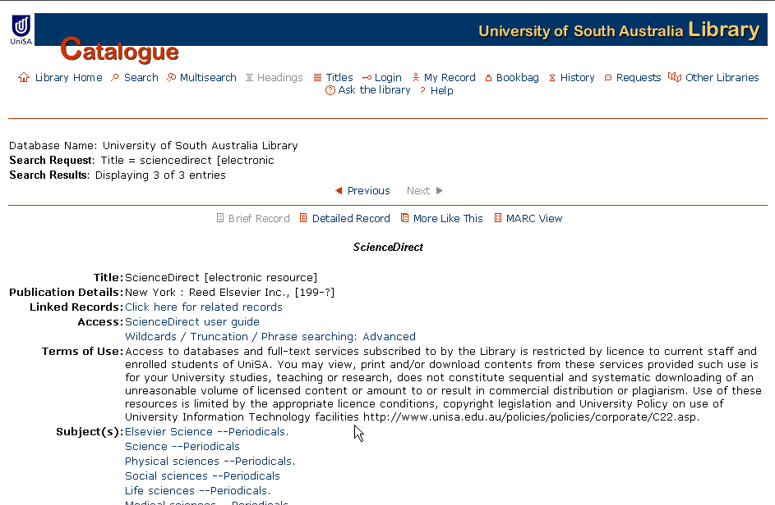
University of South Australia Library

Slide 65
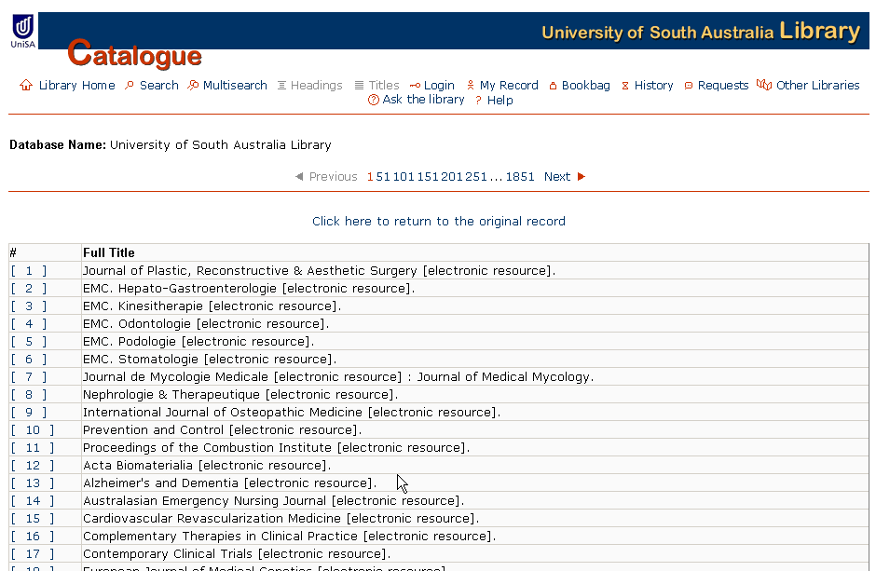
University of South Australia Library

Slide 66
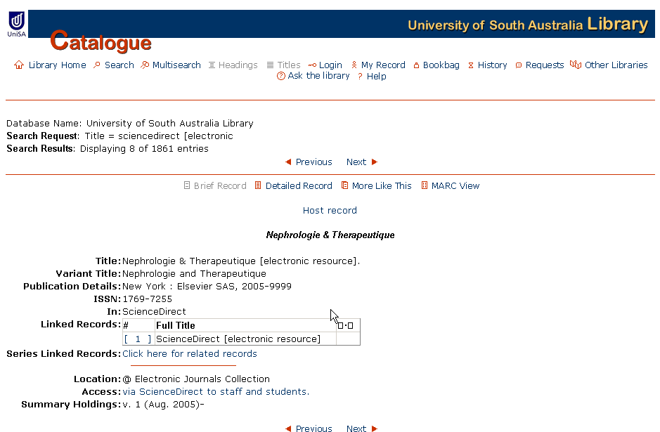
University of South Australia Library

Slide 67
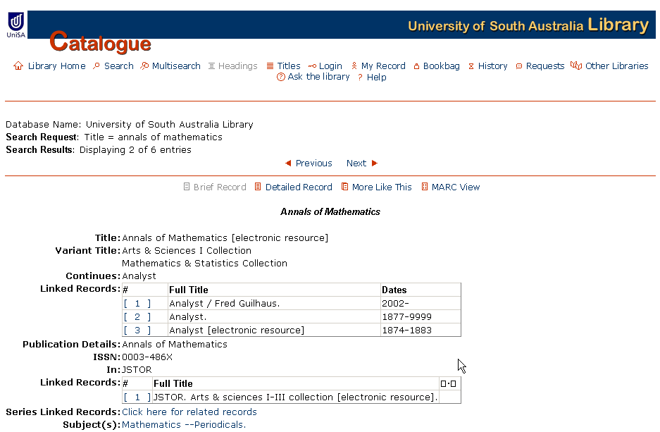
University of South Australia Library

Slide 68
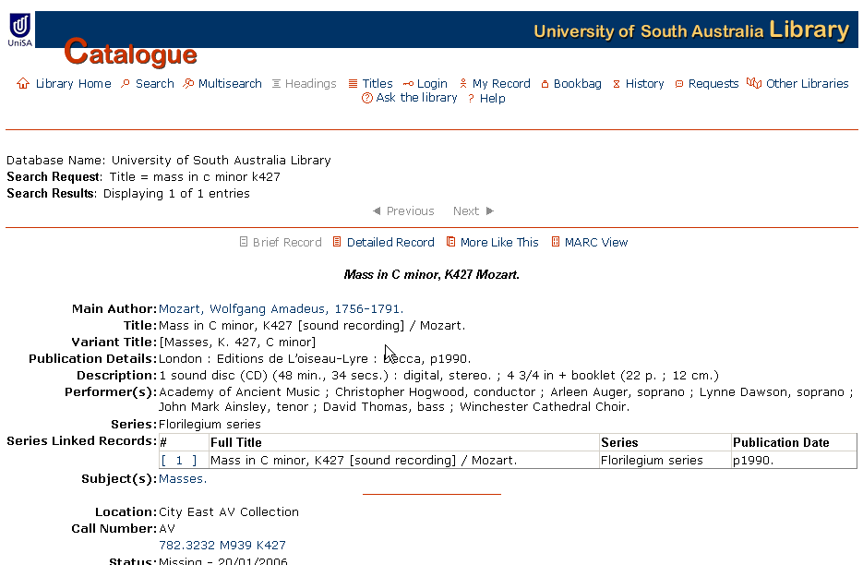
University of South Australia Library

